Slide 2
OVERALL POOL
PERFORMANCE

Slide 3
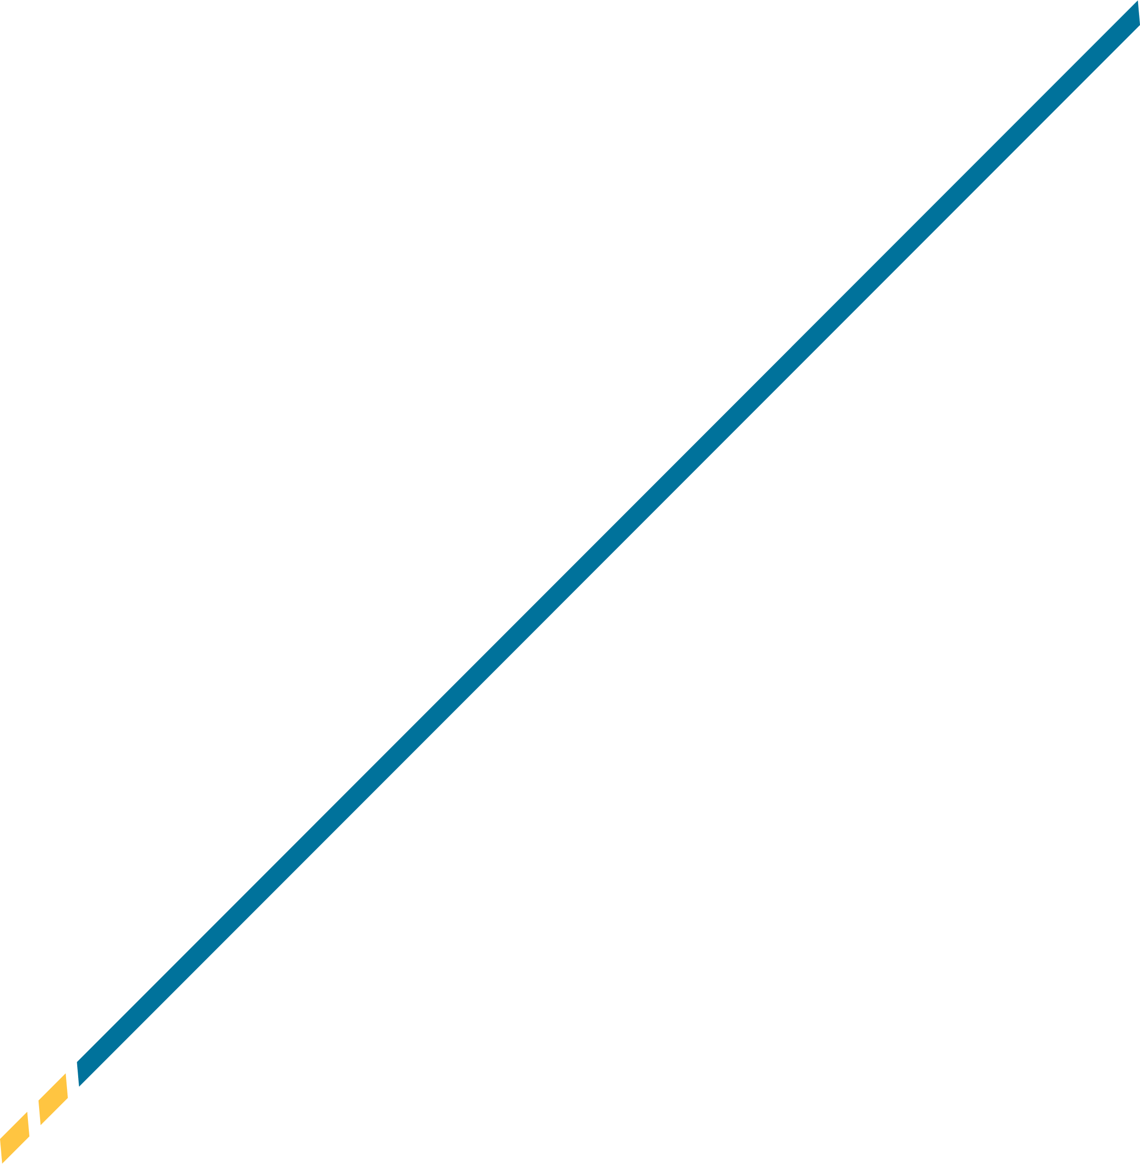
Financials as of 06.30.2024
Investment Pool | #A/C's | Market Value | Allocation
Money Market Fund | 32 | 21,649,987 | 27%
Enhanced Income Fund | 19 | 14,647,011 | 18%
Government Bond Fund | 37 | 8,267,025 | 10%
Corporate Bond Fund | 35 | 7,499,498 | 9%
S&P 500 Equity Fund | 37 | 15,957,087 | 20%
Dividend Focus Fund | 36 | 13,370,163 | 16%
 | Total | 81,390,771 | 100%
Investment Pool | 1 Month | 3 Months | YTD | FY23-24 | 1 Year | 3 Year | ITD
Government Bond Fund | 0.92 | 0.53 | (0.05) | 3.17 | 3.17 | (1.50) | (0.25)
Bloomberg US Int. Treas. Index | 0.85 | 0.58 | 0.21 | 3.37 | 3.37 | (1.41) | 0.28
Corporate Bond Fund | 0.72 | 0.28 | (0.03) | 4.27 | 4.27 | (0.69) | (0.29)
Bloomberg US Corp 1-3Yr A+ Index | 0.64 | (0.15) | (0.70) | 3.97 | 3.97 | (3.17) | 0.33
S&P 500 Equity Fund | 3.54 | 4.29 | 14.74 | 23.55 | 23.55 | 9.74 | 14.23
S&P 500 Index | 3.59 | 4.28 | 15.29 | 24.56 | 24.56 | 10.01 | 15.05
Dividend Focus Fund | 0.58 | (0.76) | 7.75 | 14.84 | 14.84 | 7.11 | 8.96
Russell 1000 Value Index | (0.94) | (2.17) | 6.62 | 13.06 | 13.06 | 5.52 | 9.04

Slide 4
Financials as of 06.30.2024
KLC Investment Pool Program Funds | CURRENT YIELD
Money Market Fund – Net | 4.99
Enhanced Income Fund (Net – YTM) | 4.90
Government Bond Fund (YTM) | 4.37
Corporate Bond Fund (YTM) | 4.80
S&P 500 Equity Fund | 1.37
Dividend Focus Fund | 2.38

Slide 5
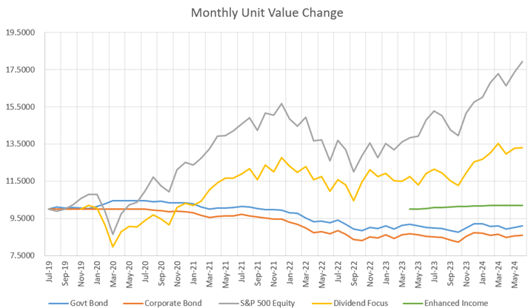
Financials as of 06.30.2024

Slide 6
INDIVIDUAL FUNDS
& CHARACTERISTICS

Slide 7
Kentucky League of Cities Investment Pool
Money Market Fund • Summary snapshot as of JUNE 30, 2024
FUND OBJECTIVES
FUND ASSETS
The Money Market Fund seeks to maintain a stable value while providing access to daily liquidity while earning a market comparable yield.
Description | Market Value ($) | Portfolio Allocation
Total Short Term | 21,655,268 | 100.0%
Total Portfolio | 21,655,268 | 100.0%
PORTFOLIO VALUE
TOTAL RETURN SUMMARY TABLE
Description | 2020 | 2021 | 2022 | 2023 | 06/30/2024
Total Portfolio (Net) | 0.46% | 0.02% | 1.48% | 4.84% | 2.69%
**Inception date is 07/01/2019
Total Portfolio (Gross) shows performance gross of advisory fees and separately managed account (SMA) fees. Performance reflects reinvestment of dividends, interest and capital gain distributions and rebalancing. Indices are unmanaged, are not available for direct investment, and are not subject to management fees, transaction costs or other types of expenses that an account may incur. Past performance is not guarantee of future results.

Slide 8
Kentucky League of Cities Investment Pool
Money Market Fund • Summary snapshot as of June 30, 2024
HISTORICAL yield chart

Slide 9
Kentucky League of Cities Investment Pool
Enhanced income fund • Summary snapshot as of June 30, 2024
FUND OBJECTIVES
FUND ASSETS
The Enhanced Income Fund seeks to protect principal and provide a stable NAV by investing in Money Market Funds and US Treasury securities purchased at a discount and held to maturity and providing a consistent income stream that is greater than a money market fund.
Description | Market Value ($) | Portfolio Allocation
Total Fixed Income | 9,305,315 | 63.8%
Total Short Term | 5,291,664 | 36.2%
Total Portfolio | 14,596,979 | 100.0%
Portfolio Value
YIELD SUMMARY TABLE
Description | May 2023 | June 2023 | July 2023 | August 2023 | Sept. 2023 | Dec. 2023 | March 2024 | June 2024
Total Portfolio (Net) | 4.95 | 4.97 | 5.04 | 5.07 | 5.08 | 5.15 | 5.05 | 4.90
**Inception date is 05/08/2023
Total Portfolio (Gross) shows performance gross of advisory fees and separately managed account (SMA) fees. Total Portfolio (Net) shows performance net of advisory fees, transaction costs, and all manager fees. Performance reflects reinvestment of dividends, interest and capital gain distributions and rebalancing. Indices are unmanaged, are not available for direct investment, and are not subject to management fees, transaction costs or other types of expenses that an account may incur. Past performance is not guarantee of future results.

Slide 10
Kentucky League of Cities Investment Pool
Government Bond Fund • Summary snapshot as of June 30, 2024
FUND OBJECTIVES
FUND ASSETS
The Government Bond Fund invests in short and intermediate term obligations of the United States and of its agencies and instrumentalities. The portfolio targets a weighted average effective duration of 4 years with maturities ranging from 1-7 years.
Description | Market Value ($) | Portfolio Allocation
Total Fixed Income | 7,945,362 | 96.7%
Total Short Term | 272,414 | 3.3%
Total Portfolio | 8,217,776 | 100.0%
PORTFOLIO PERFORMANCE
SUMMARY TABLE
Description | 3 Month | 1 Year | 3 Year | ITD**
Total Portfolio (Gross) | 0.57% | 3.17% | -1.50% | -0.25%
Total Portfolio (Net) | 0.48% | 2.99% | -1.73% | -0.48%
Bloomberg 1-3 Yr. Govt | 0.58% | 3.37% | -1.41% | 0.36%
**Inception date is 07/01/2019
Total Portfolio (Gross) shows performance gross of advisory fees and separately managed account (SMA) fees. Total Portfolio (Net) shows performance net of advisory fees, transaction costs, and all manager fees. Performance reflects reinvestment of dividends, interest and capital gain distributions and rebalancing. Indices are unmanaged, are not available for direct investment, and are not subject to management fees, transaction costs or other types of expenses that an account may incur. Past performance is not guarantee of future results.

Slide 11
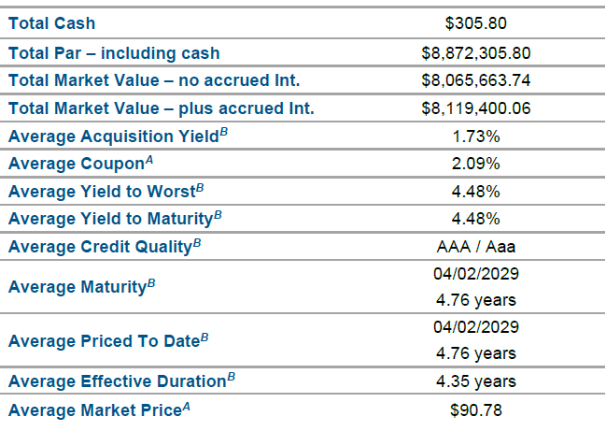
Kentucky League of Cities Investment Pool
Government Bond Fund • Summary snapshot as of June 30, 2024
PORTFOLIO CHARACTERISTICS

Slide 12
Kentucky League of Cities Investment Pool
corporate Bond Fund • Summary snapshot as of June 30, 2024
FUND OBJECTIVES
FUND ASSETS
The Corporate Bond Fund invests in individual corporate bonds that: 1. Are issued, assumed, or guaranteed by a solvent institution created and existing under the laws of the United States; 2. Have a standard maturity of no more than ten years; and 3. Are rated A or better by at least two Nationally Recognized Statistical Rating Organizations (NRSRO).
Description | Market Value ($) | Portfolio Allocation
Total Fixed Income | 7,268,801 | 97.9%
Total Short Term | 159,077 | 2.1%
Total Portfolio | 7,427,879 | 100.0%
PORTFOLIO PERFORMANCE
SUMMARY TABLE
Description | 3 Month | 1 Year | 3 Year | ITD**
Total Portfolio (Gross) | 0.28% | 4.27% | -0.69% | -0.29%
Total Portfolio (Net) | 0.24% | 4.09% | -0.92% | -0.51%
Bloomberg Corporate 1-3 YR A+ | -0.15% | 3.97% | -3.17% | 0.44%
**Inception date is 07/01/2019
Total Portfolio (Gross) shows performance gross of advisory fees and separately managed account (SMA) fees. Total Portfolio (Net) shows performance net of advisory fees, transaction costs, and all manager fees. Performance reflects reinvestment of dividends, interest and capital gain distributions and rebalancing. Indices are unmanaged, are not available for direct investment, and are not subject to management fees, transaction costs or other types of expenses that an account may incur. Past performance is not guarantee of future results.

Slide 13
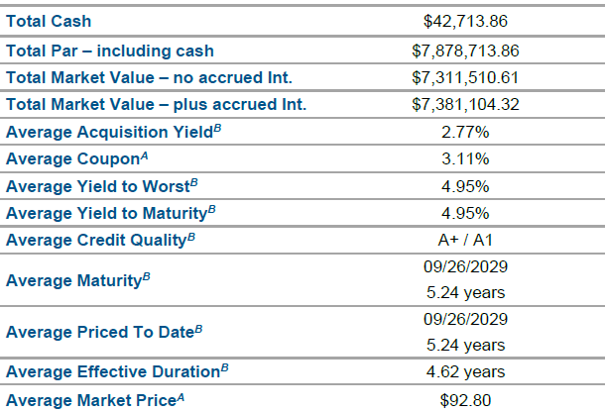
Kentucky League of Cities Investment Pool
Corporate Bond Fund • Summary snapshot as of June 30, 2024
PORTFOLIO CHARACTERISTICS

Slide 14
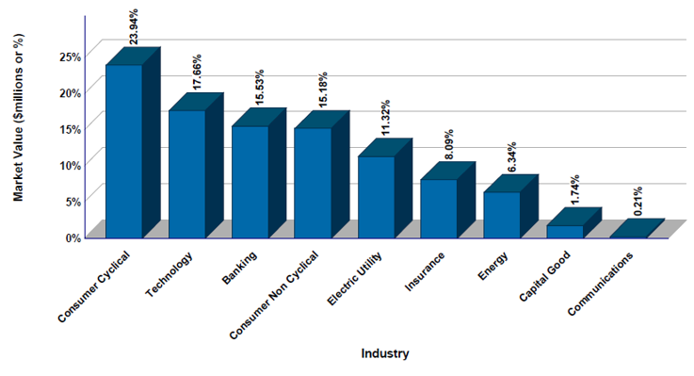
Kentucky League of Cities Investment Pool
Corporate Bond Fund • Summary snapshot as of June 30, 2024

Slide 15
Kentucky League of Cities Investment Pool
Dividend Focus Fund • Summary snapshot as of June 30, 2024
FUND OBJECTIVES
FUND ASSETS
The Dividend Focus Equity fund seeks to invest in high-quality domestic S&P 500 stocks that consistently beat earnings estimates and grow dividends. We believe these companies can over time provide above-average returns and hedge against inflation.
Description | Market Value ($) | Portfolio Allocation
Total Equity | 13,267,698 | 99.4%
Large Cap Equity | 13,267,698 | 99.4%
Total Short Term | 85,938 | 0.6%
Total Portfolio | 13,353,636 | 100.0%
PORTFOLIO PERFORMANCE
SUMMARY TABLE
Description | 3 Month | 1 Year | 3 Year | ITD**
Total Portfolio (Gross) | -0.76% | 14.84% | 7.11% | 8.96%
Total Portfolio (Net) | -0.80% | 14.64% | 6.88% | 8.71%
Russell 1000 Value | -2.17% | 13.06% | 5.52% | 8.45%
**Inception date is 11/01/2019
Total Portfolio (Gross) shows performance gross of advisory fees and separately managed account (SMA) fees. Total Portfolio (Net) shows performance net of advisory fees, transaction costs, and all manager fees. Performance reflects reinvestment of dividends, interest and capital gain distributions and rebalancing. Indices are unmanaged, are not available for direct investment, and are not subject to management fees, transaction costs or other types of expenses that an account may incur. Past performance is not guarantee of future results.
15

Slide 16
Kentucky League of Cities Investment Pool
Dividend Focus Fund • Summary snapshot as of June 30, 2024
Sector Allocation (%)
DIVIDEND FOCUS FUND |  |  | Russell 1000 Value Index
 | Communication Services | 3.9 | 4.5
 | Consumer Discretionary | 5.3 | 4.7
 | Consumer Staples | 7.3 | 7.9
 | Energy | 7.5 | 7.8
 | Financials | 21.0 | 22.9
 | Health Care | 15.1 | 13.9
 | Industrials | 15.2 | 14.3
 | Information Technology | 10.5 | 9.5
 | Materials | 3.7 | 4.7
 | Real Estate | 3.4 | 4.6
 | Utilities | 4.6 | 5.2
 | Cash & Cash Equivalents | 2.5 | 0.0
Dividend Focus
FUND

Slide 17
Kentucky League of Cities Investment Pool
Dividend Focus Fund • Summary snapshot as of June 30, 2024
Portfolio Characteristics
 | DIVIDEND FOCUS FUND | RUSSELL 1000 VALUE INDEX
Weighted Average Market Cap ($MM) | $322,174 | $158,275
Price/Earnings Ratio (12-month forward) | 16.5 | 15.3
Price/Earnings Ratio (12-month trailing) | 18.2 | 17.2
Price to Cash Flow | 14.1 | 11.2
Price to Sales | 2.7 | 1.7
12 Month Return on Equity | 27.1% | 13.9%
Turnover (12-month trailing) | 25.7% | N/A
Dividend Yield | 2.3% | 2.2%
Top 10 Holdings
 | % of Portfolio | % of Portfolio
JPMorgan Chase & Co | 4.2 Bank of America Corp | 2.5
Merck & Co Inc | 3.1 Chevron Corp | 2.3
Eli Lilly & Co | 2.9 Exxon Mobil Corp | 2.1
Broadcom Ltd | 2.5 Air Products & Chemicals Inc | 2.0
Procter & Gamble | 2.5 Microsoft Corp | 1.9

Slide 18
Kentucky League of Cities Investment Pool
S&P 500 Equity Fund • Summary snapshot as of June 30, 2024
FUND OBJECTIVES
FUND ASSETS
The Equity Fund invests in the S&P 500 using an exchange traded fund that tracks the S&P 500 index.
Description | Market Value ($) | Portfolio Allocation
Total Equity | 15,794,699 | 99.0%
Large Cap Equity | 15,794,699 | 99.0%
Total Short Term | 155,338 | 1.0%
Total Portfolio | 15,950,038 | 100.0%
PORTFOLIO PERFORMANCE
SUMMARY TABLE
Description | 3 Month | 1 Year | 3 Year | ITD**
Total Portfolio (Gross) | 4.29% | 23.55% | 9.74% | 14.23%
Total Portfolio (Net) | 4.24% | 23.34% | 9.49% | 13.98%
S&P 500 TR | 4.28% | 24.56% | 10.01% | 14.68%
**Inception date is 07/01/2019
Total Portfolio (Gross) shows performance gross of advisory fees and separately managed account (SMA) fees. Total Portfolio (Net) shows performance net of advisory fees, transaction costs, and all manager fees. Performance reflects reinvestment of dividends, interest and capital gain distributions and rebalancing. Indices are unmanaged, are not available for direct investment, and are not subject to management fees, transaction costs or other types of expenses that an account may incur. Past performance is not guarantee of future results.

Slide 19
Kentucky League of Cities Investment Pool
S&P 500 Equity Fund • Summary snapshot as of June 30, 2024
TOP 10 HOLDINGS
 | % of Portfolio |  | % of Portfolio
Microsoft Corp | 7.28% | Alphabet Inc Class A | 2.35%
NVIDIA Corp | 6.74% | Alphabet Inc Class C | 1.97%
Apple Inc | 6.55% | Berkshire Hathaway Inc Class B | 1.62%
Amazon.com Inc | 3.71% | Eli Lilly and Co | 1.57%
Meta Platforms Inc Class A | 2.43% | Broadcom Inc | 1.50%

